Slide 1


SAP Cloud Integration
Training
ON THE
SAP BUSINESS TECHNOLOGY PLATFORM
Date: Dec 19th, 2022
Time: 9:00AM IST
Facilitator: Anu
www.anubhavtrainings.com

Slide 2
Agenda
Mapping

Slide 3
Message Mapping
Message Mapping is nothing but a set of rules for producing target XML from the source XML.
These rules are nothing but relations between the source XML tags and target XML tags”
For example, consider the record Employee and we need to update the employee identification number. In the sender system, the field name is Employee ID. However, in the receiver system, the same field is called ID.

Slide 4
Source Field | Target Field
Employee | User
Employee ID | ID
Employee Name | Name
Employee Surname | LastName
Date of Birth | DOB

Slide 5
Use
You use message mapping, to define an association between fields of messages with different structuring. This enables the Cloud Integration system to recognize and update the relevant fields in the target systems.

Slide 7
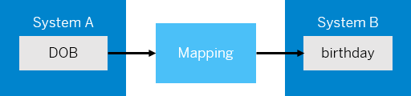
Standard and Custom Mapping Functions
In the same scenario, let us assume that the date of birth in system A is in YYYY-MM-DD format. You want to change the format to DD-MM-YYYY, the format in system B. In this case, you can use a mapping function that transforms the data into the format that you want, which in this case is DD-MM-YYYY.

Slide 8
The mapping editor provides some standard functions like Arithmetic, Boolean, Constants, Conversions, and Date.
If you're unable to achieve the desired transformation using standard functions, you can create a custom function in one of the following ways.Choose  (create script) to create a custom-mapping function by manually entering the script.
Choose  (add script file) to upload a script file that contains the custom-mapping function.

Slide 9
Testing Message Mapping
The mapping editor provides 2 ways of testing message mapping:Simulate – for testing the entire mapping XML.
Display Queue – for testing a specific node of the XML.

Slide 10
Testing Message Mapping
The mapping editor provides 2 ways of testing message mapping:Simulate – for testing the entire mapping XML.
Display Queue – for testing a specific node of the XML.

Slide 11
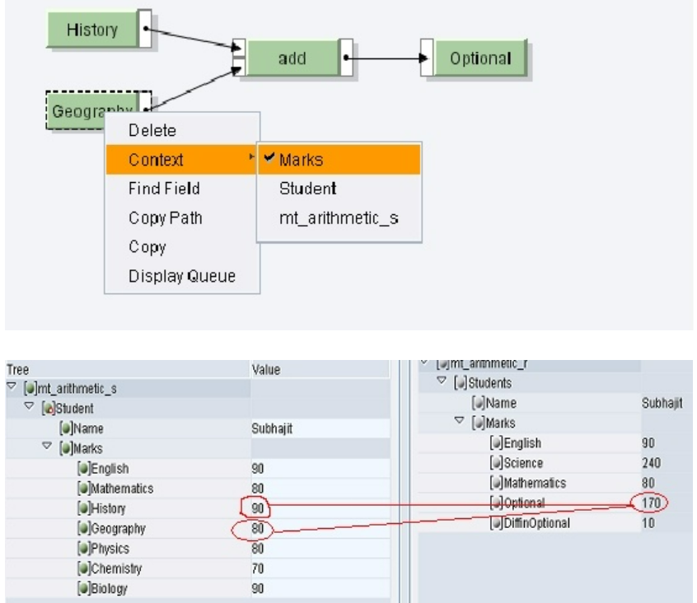
Mapping
Add

Slide 12
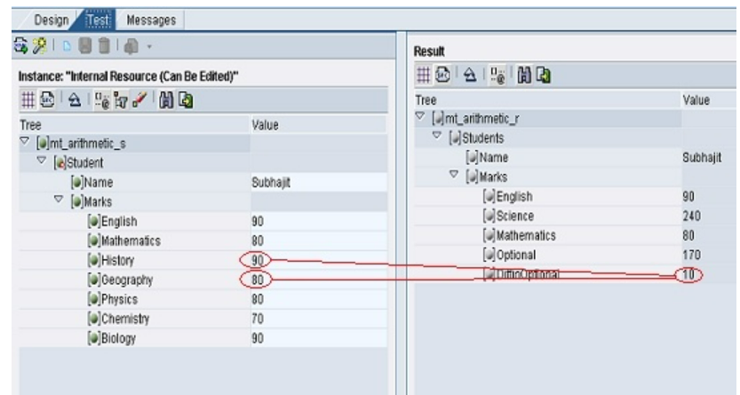
Mapping
Substract

Slide 13
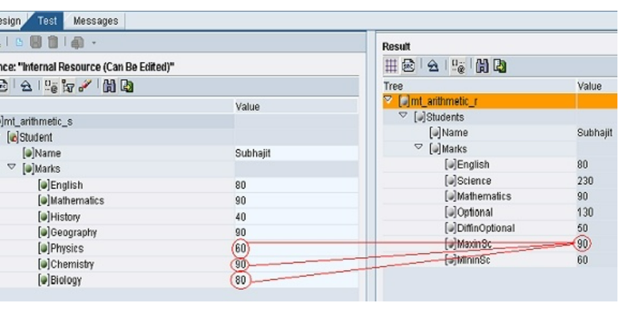
Max and MIn

Slide 14
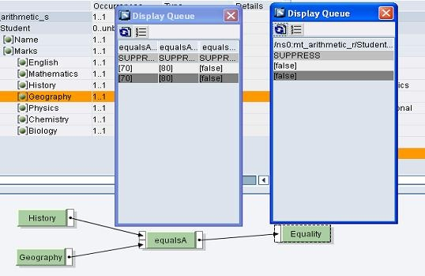
equalsA: This function takes the two float inputs, compares them and returns 'true' if the values are equal else 'false'.

Slide 15
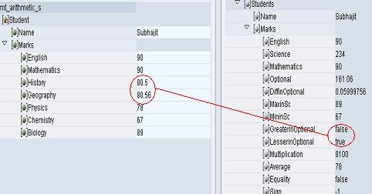
greater: This function takes two input values and compares them. If the first value is greater than the second one, the output is 'true' else 'false'. less: This function takes two input values and compares them. If the first value is less than the second one, the output is 'true' else 'false'.

Slide 16
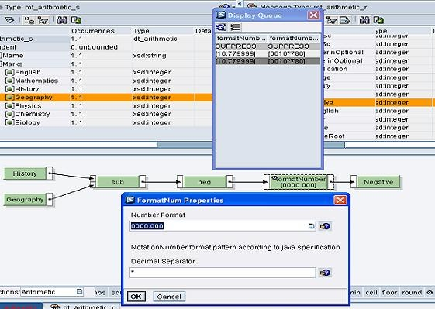
FormatNum: This standard function helps in displaying the result in the required format

Slide 17
Constants:
The standard functions of the Constants function category do not have an input value. Therefore, they generate a value for a target field instead of taking it from a source field. . In addition to these functions, all functions (regardless of whether they are standard or user-defined functions) that do not have input values are referred to as Generating Functions.
CONSTANT: O gets any string constant that you can enter in the dialog for the function properties.

Slide 18
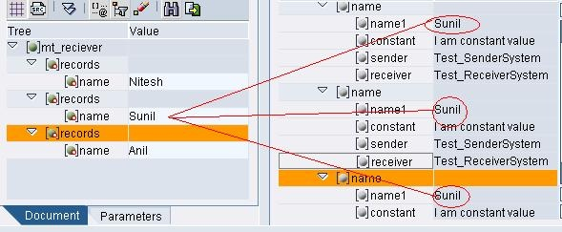
Mapping
Copy Value

Slide 19
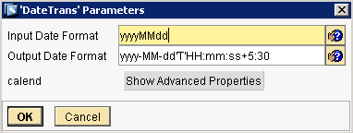
Mapping
Date Functions
Date and time functions are scalar functions that perform an operation on a date and time input value and returns either a string, numeric, or date and time value.

Slide 20
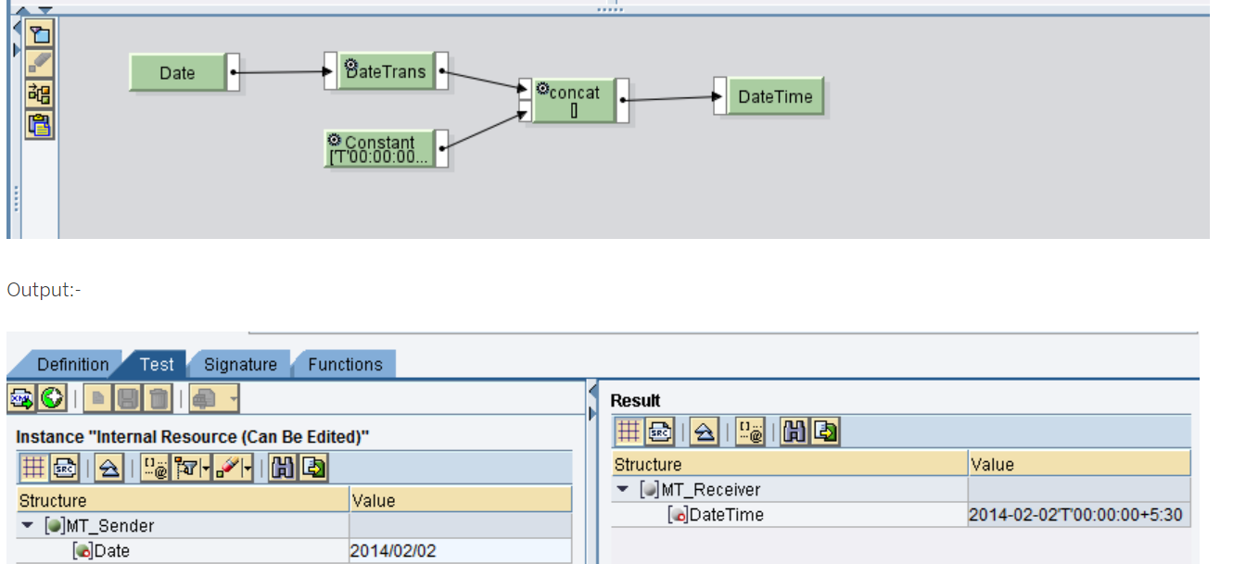
concatenate

Slide 21
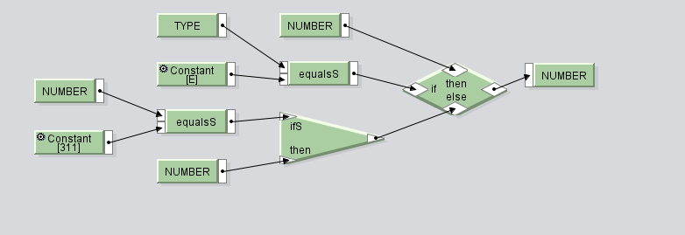
If else condition

Slide 22
Mapping Function
equalsS Function available in Text Function
R = true, if string X equals string Y, otherwise R = false

Slide 23
If Else
If without else
And
Or

Slide 24
Context
XML messages in CPI are handled as Queues. In a queue, Context is the position or the level of a XML node (element) relative to a parent node. If elements belong to the same parent node, the elements are in same Context. When the parent node changes, Context Change is inserted to the queue. Context Changes are shown in dark gray color

Slide 25
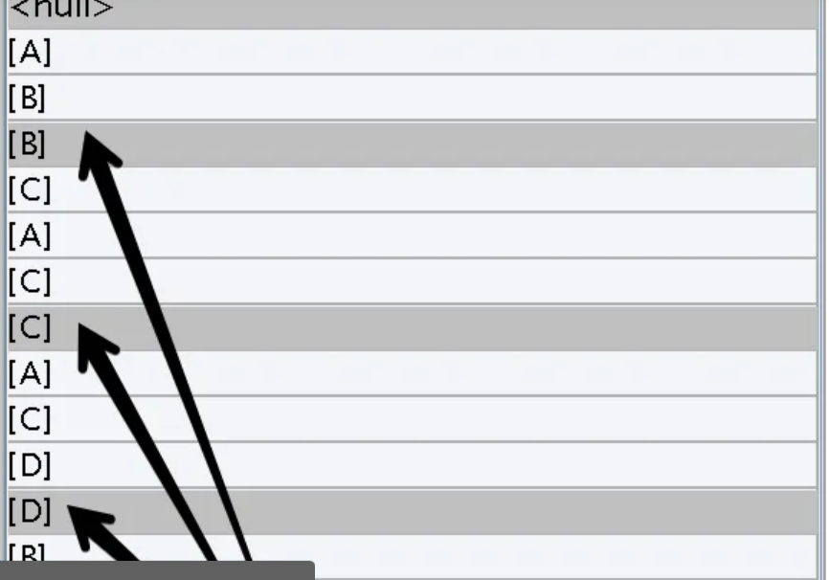

Slide 27
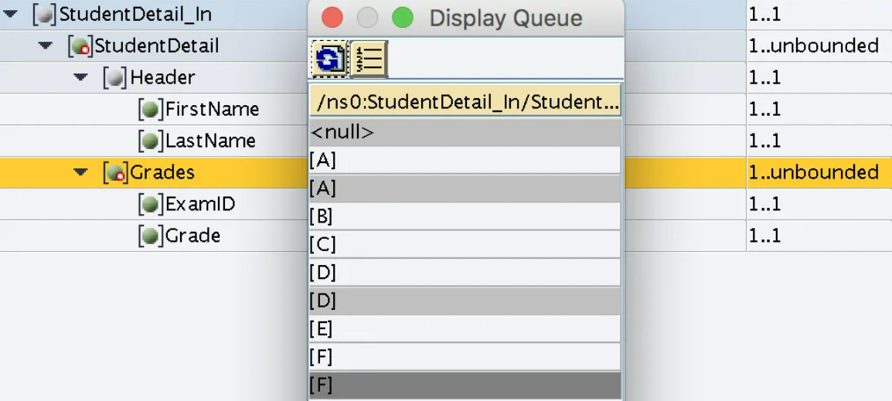

Slide 28
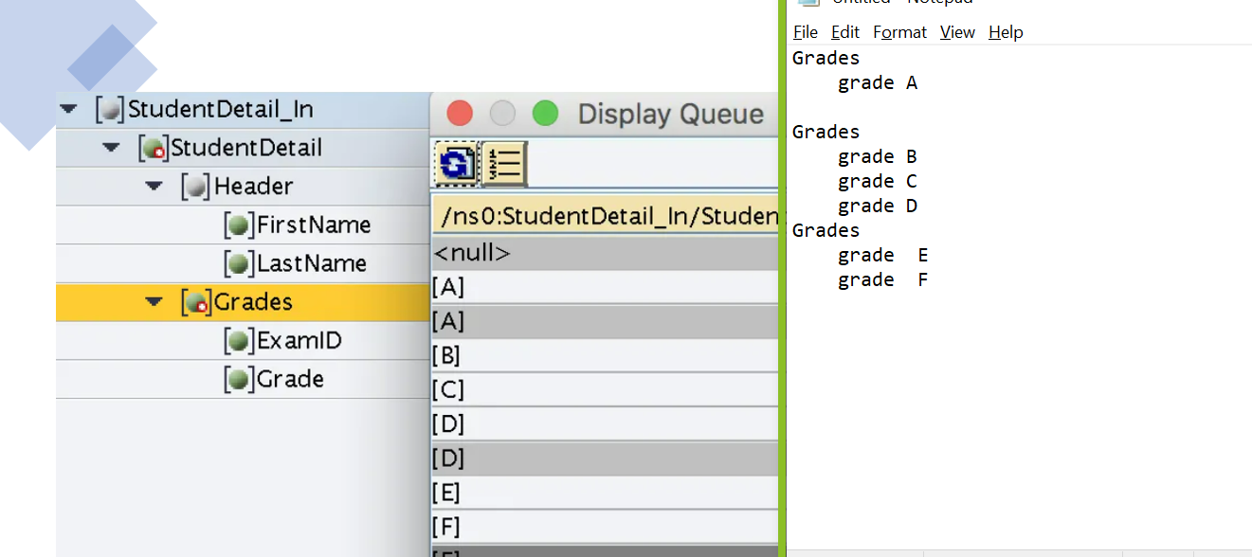

Slide 31
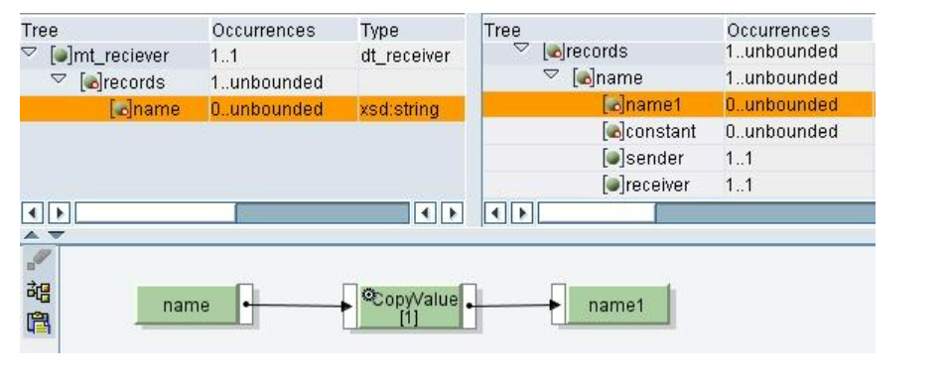
Copy value

Slide 32
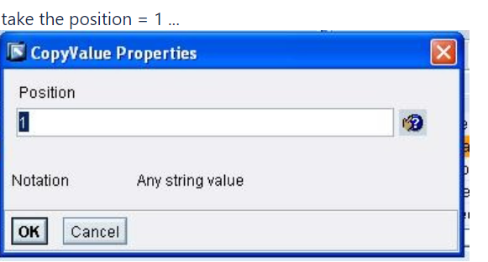

Slide 33
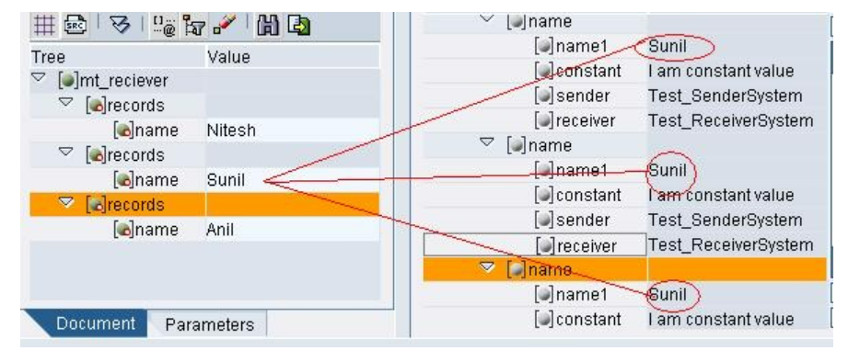

Slide 34
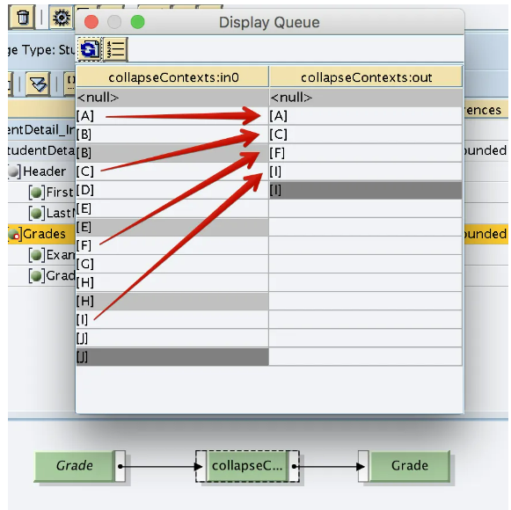
Collpase context

Slide 35
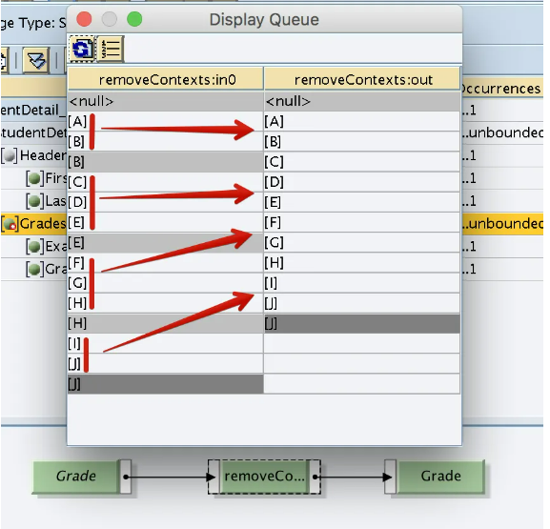
Remove context

Slide 36
Node function

Slide 37
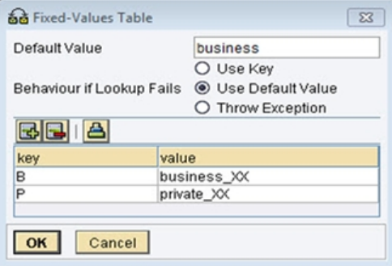
Mapping
FixValues
FixValues is a standard function of the Conversions function group; it enables fixed value pairs to be saved in a message mapping
this function generally used for fixed value transfermations during message mapping based on key values.

Slide 38
Remove context

Slide 40
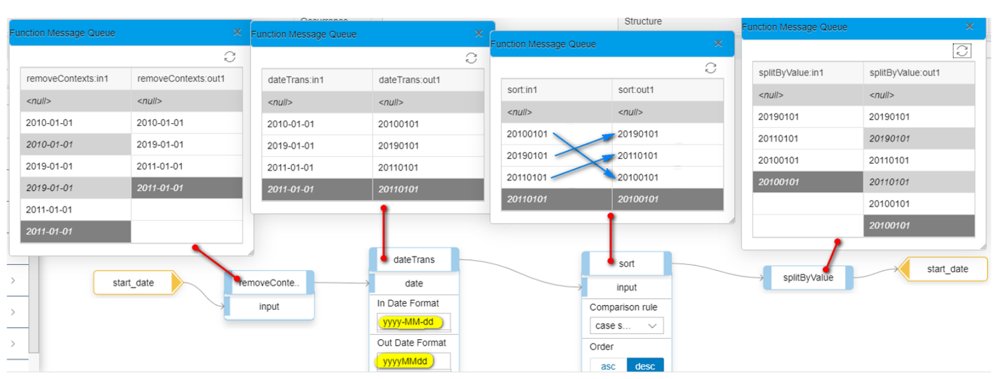
Sort Function
Sort simply sorts an array in ascending or descending order, depending on your choice. SortByKey arranges one array on the sorting order of another array

